Slide 1

IWIC APPLICATION.
Wireframes and maps

Slide 2

Mobile maps
Maps API and its uses within the application
Notes:
Talk about what was required in the brief
Include the key which needs to be obtained by IWIC
Include the different benefits to using the google maps API

Slide 3
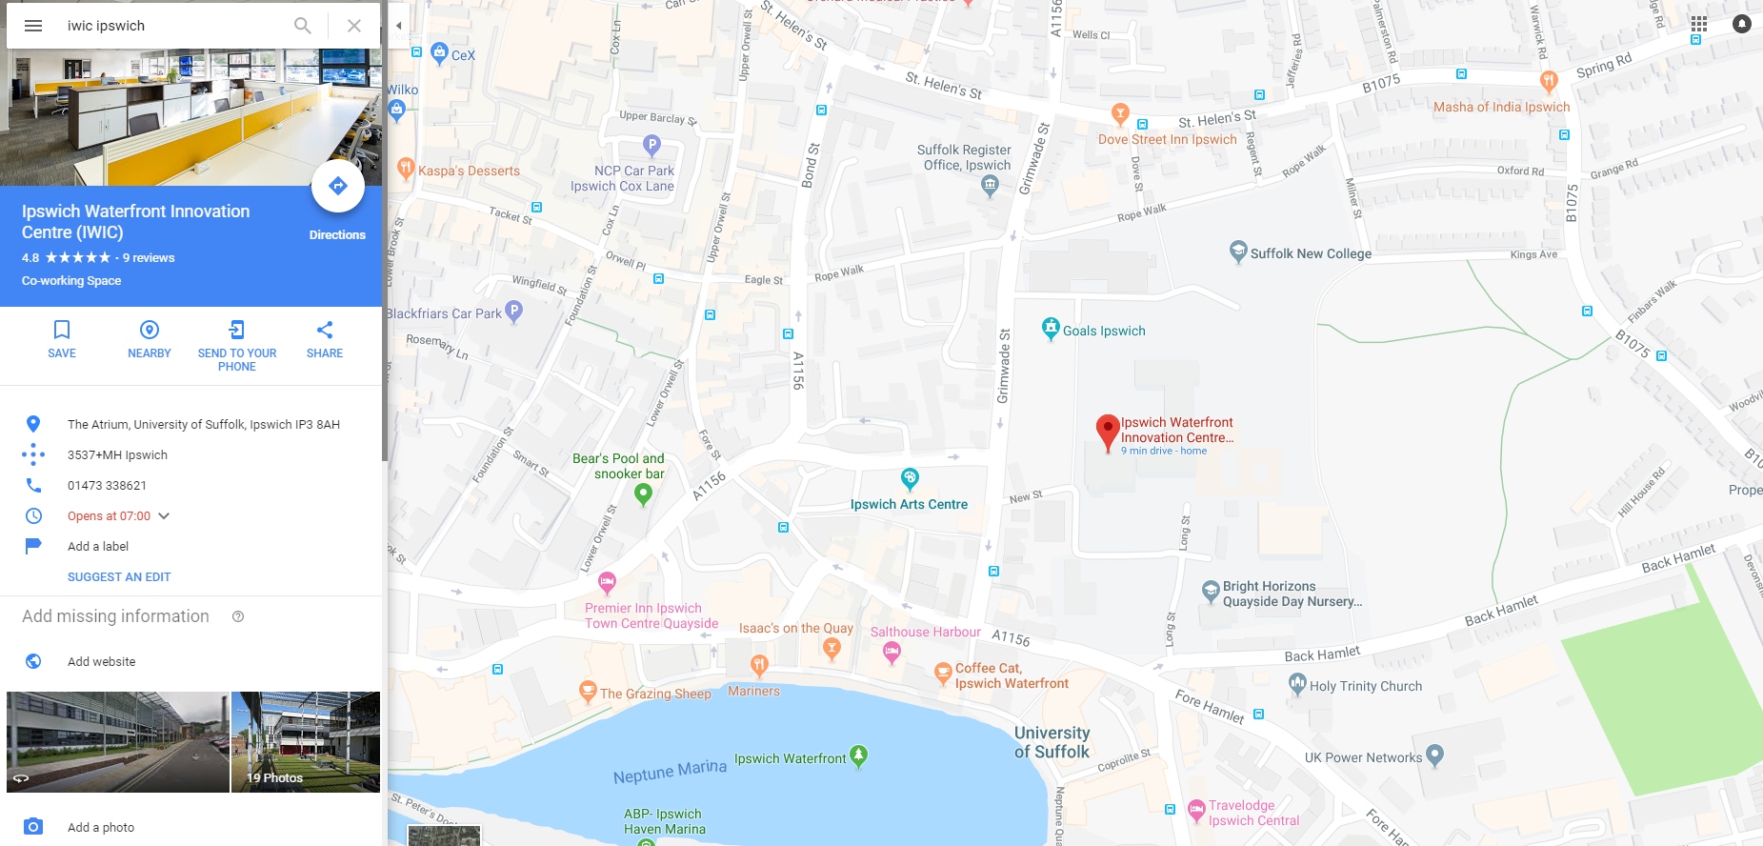

Slide 4
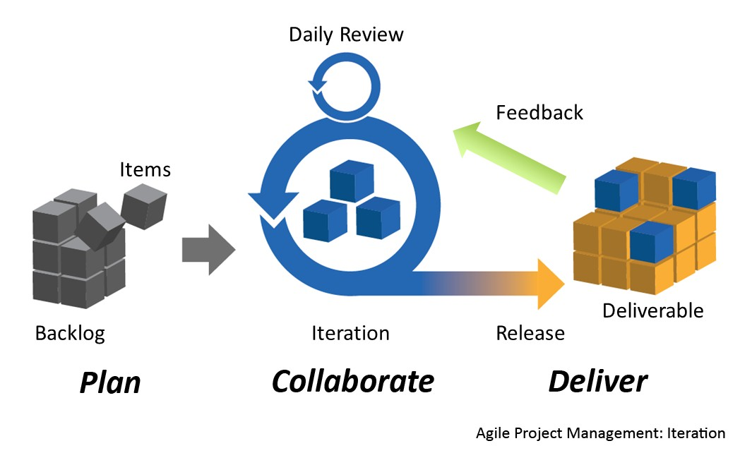
Wireframes
Notes:
Talk about the cycle in which they will be created.
Talk about continuity across all the interfaces within the application
Also ask questions about what they expect from the admin interfaces.

Slide 5
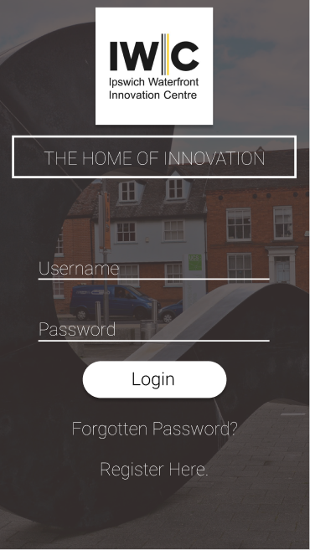
Sign in
First impressions
Is it clear ?
Is it a true representation of IWIC ?

Slide 6
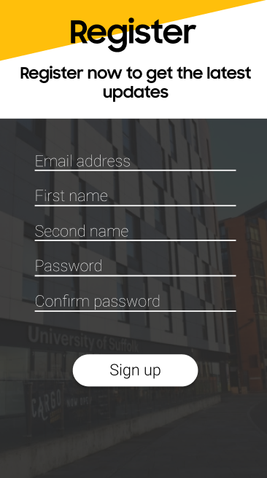
Register
Is it upkeeping the IWIC branding ?
Is the purpose obvious to you ?

Slide 7
Home screen
Is there too much going on ?
Is it simple enough for anyone to use ?

Slide 8
Alternate Home screen

Slide 9
Reminders screen
Does it have a sense of urgency about it
Is it consistent with the rest of the application

Slide 10



THANK YOU
ALEX JACOBS
+447393953972
ALEXJACOBS98@GMAIL.COM

